Slide 1

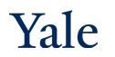
Deep Learning Theory and Applications Neural ODE
CPSC/AMTH 663
CPSC 452

Slide 2
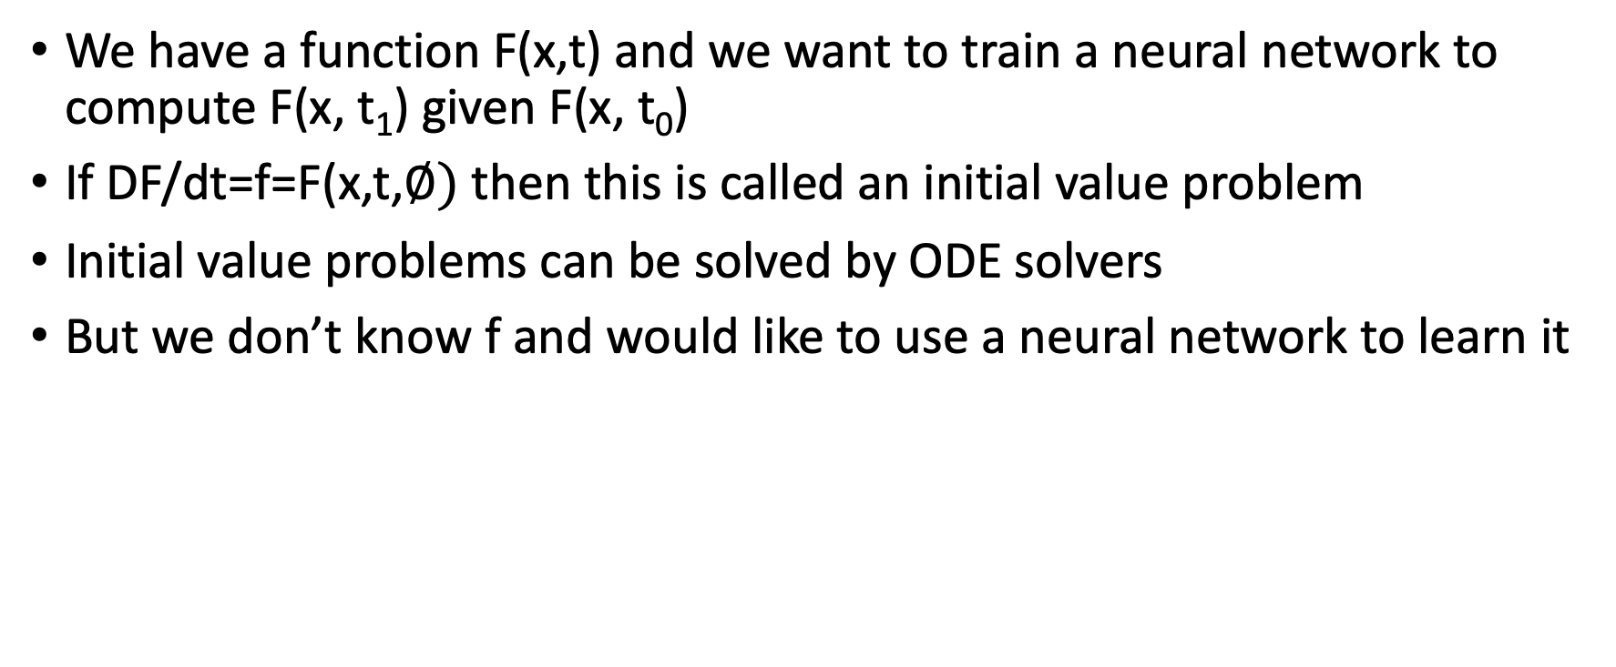
Neural ODE Problem Setup
We have a function F(x,t) and we want to train a neural network to compute F(x, t₁) given F(x, t₀)
If DF/dt=f=F(x,t,$∅)$ then this is called an initial value problem
Initial value problems can be solved by ODE solvers
But we don’t know f and would like to use a neural network to learn it

Slide 3
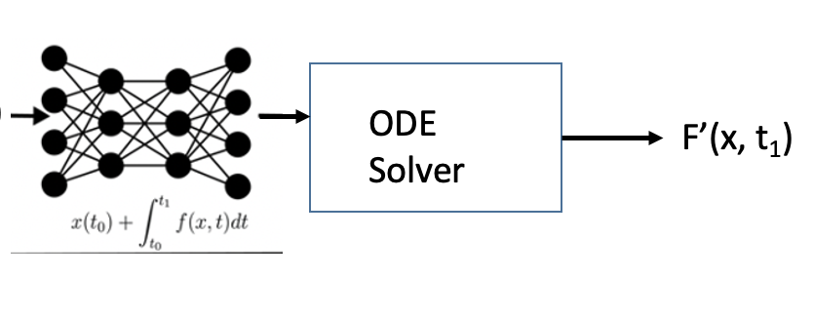

Neural ODE Recap
Neural network learns the derivative f = dF/dt
The derivative is “parameterized by a neural network”
To compute F(x,t₁) given F(x, t₀) we use an ODE solver
ODE solver can sample as much as it wants between t₀ and t₁
F(x, t0)
f

Slide 4
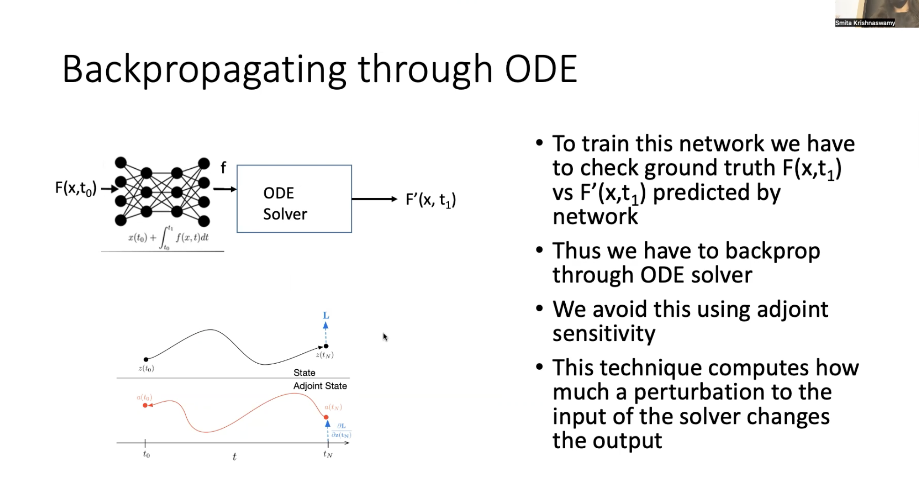
design a NN to
compute derivative f
input value
at t0
predicted
value at t1
backpropagate the loss through ODE Solver and network use adjoint sensitivity
skip backpropagate ODE Solver bc we don’t care training params in the ODE Solver
we only care about training params in the neural net
adjoint sensitivity looks at stability
ODE Solver can sample any time points
by integrating the derivative f

Slide 5
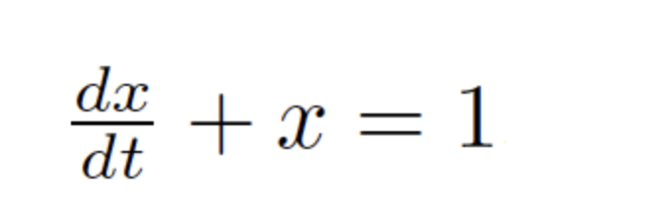
Ordinary Differential Equations
Describes the time-evolution or “dynamics” via its derivative
“Solving a differential equation” refers to starting at some initial condition x(0) and evolving the system up to x(t)
The solution is called the integral curve because it involves integrating the equation to get the solution

Slide 6
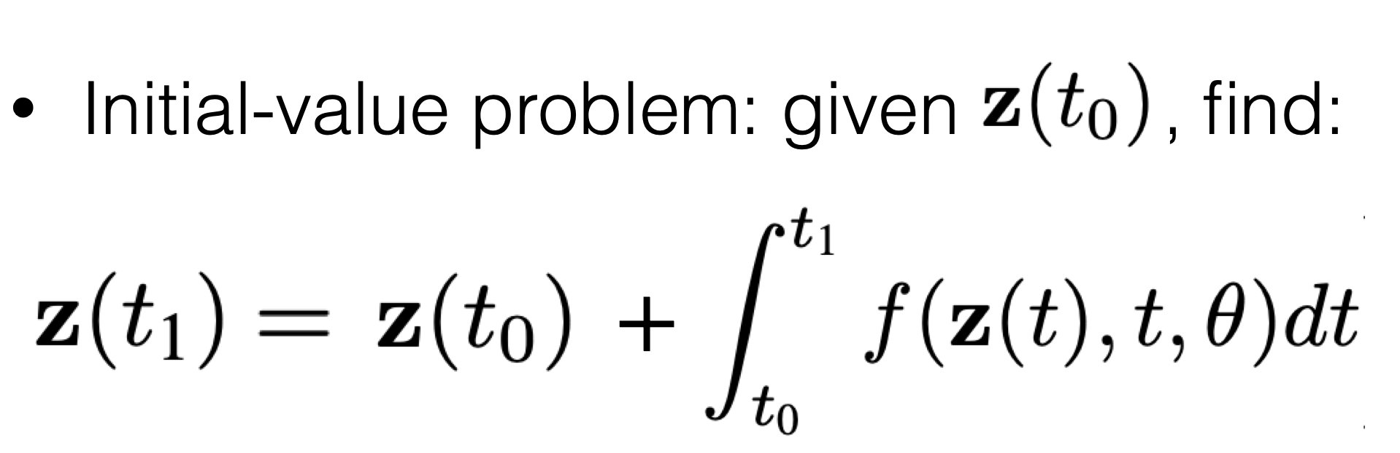
Initial Value problem

Slide 7
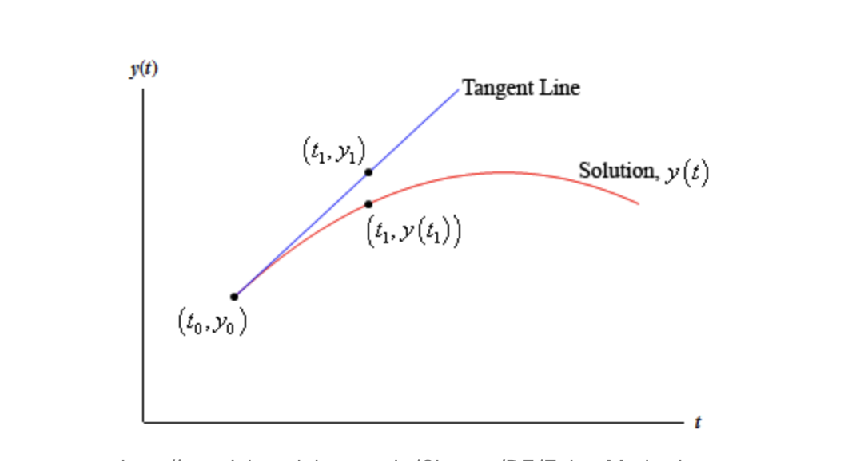
Euler’s Method
One of the simplest methods for solving a differential equation
Approximates the solution step by step using tangent lines

Slide 8
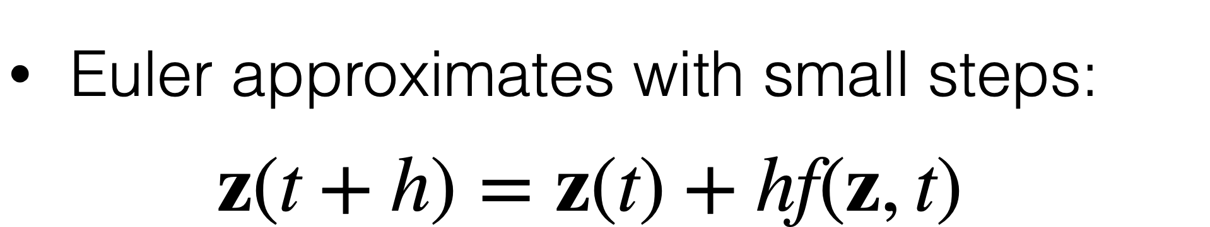
Euler’s Method

Slide 9
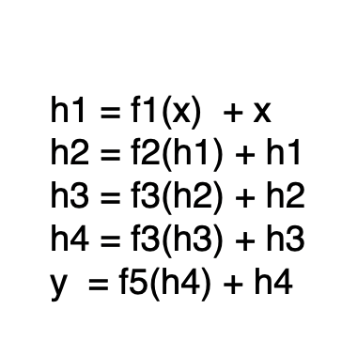
Recall Resnets
h1 = f1(x)
h2 = f2(h1)
h3 = f3(h2)
h4 = f3(h3)
y = f5(h4)

Slide 10
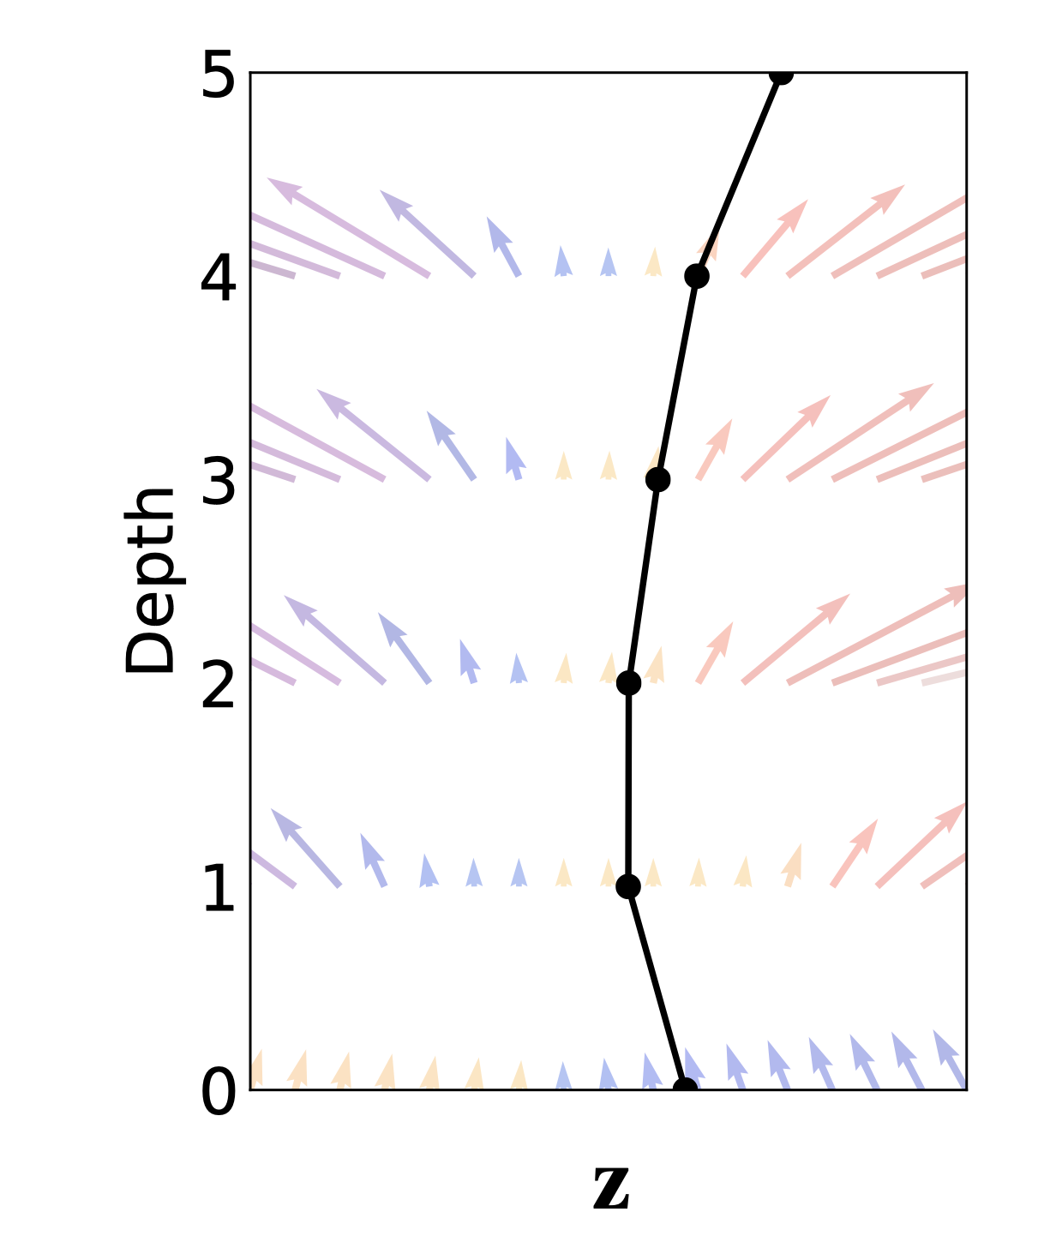
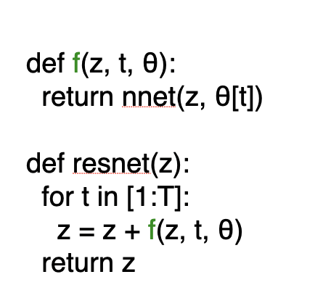
Resnets as Euler Integrators

Slide 11
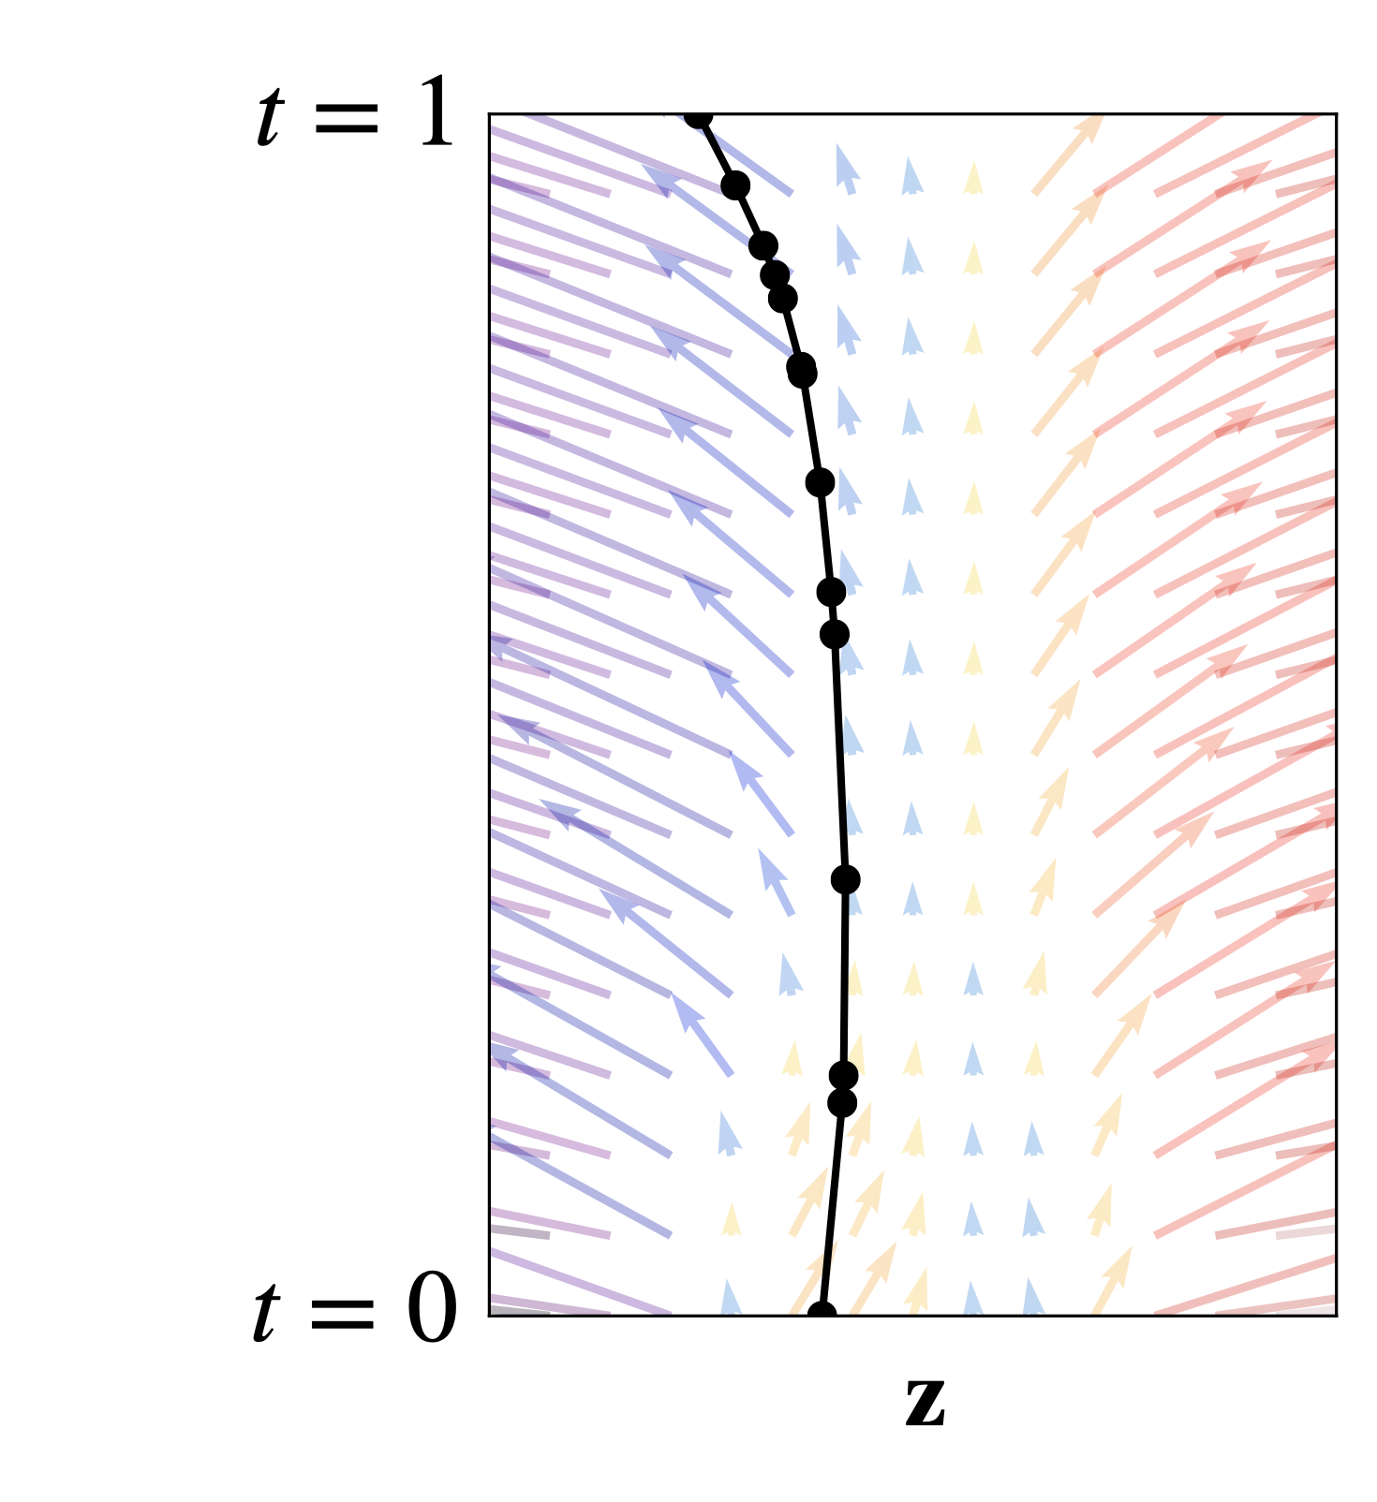
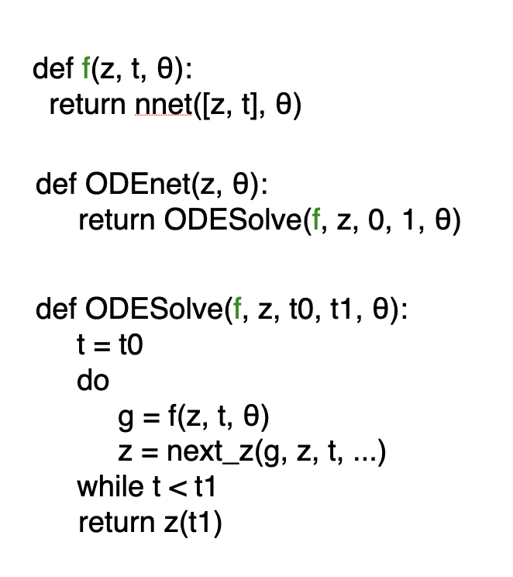
ODEnet
1. Replace a resnet step with a call to an ODE solver
2. Internally the ODE solver evaluates dynamics wherever it wants

Slide 12
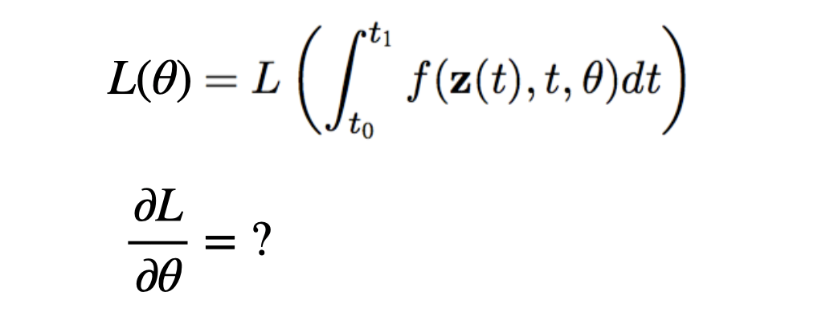
How do we train ODE-net?
ODE-net layers are calls to ODE solvers
This means that in order to train ODE-net we would have to backpropagate through operations of the ODE-solver!

Slide 13
Avoiding Backprop through ODE Solver!
Backpropagating through operations of the ODE solver are expensive
1. We would have to store intermediary operations of the ODE solver and this would be hard in terms of memory
2. This would build up numerical errors as well in practice
Solution: approximate the differentiation through a solver
Duvenaud: “Don’t differentiate the approximation, approximate the derivative!”

Slide 14
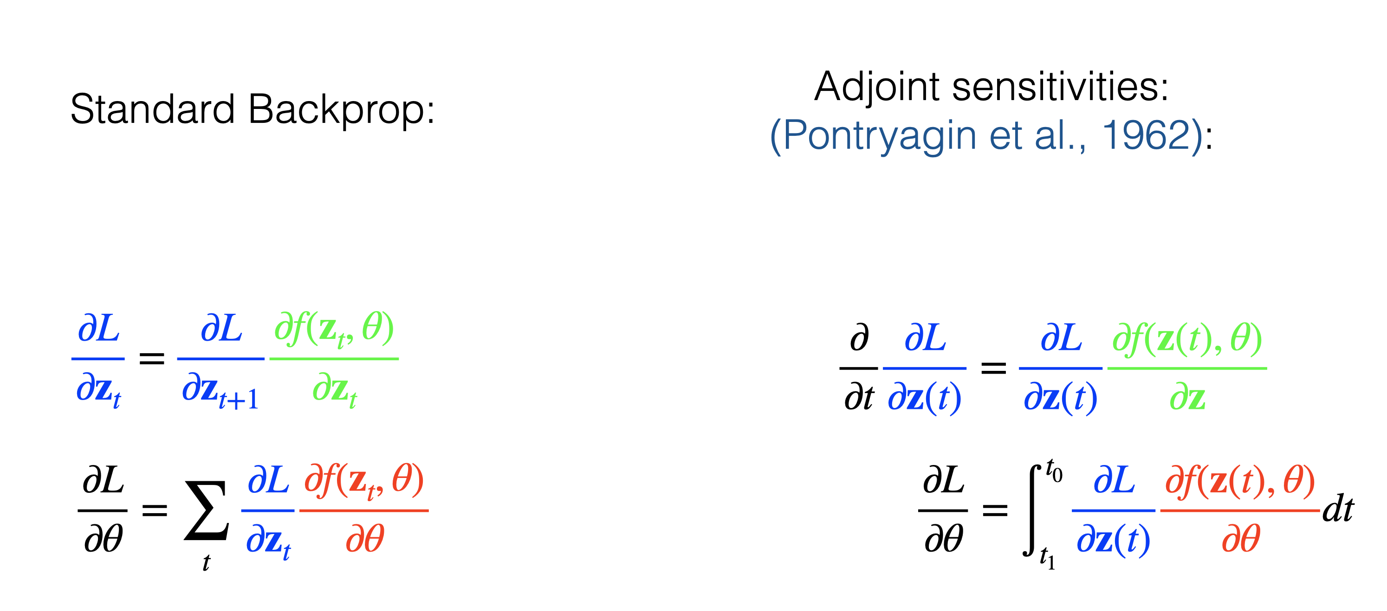
Adjoint Sensitivity to Compute Gradients
Reverse mode differentiation through time steps
Continuous limit of this gives adjoint sensitivities

Slide 15
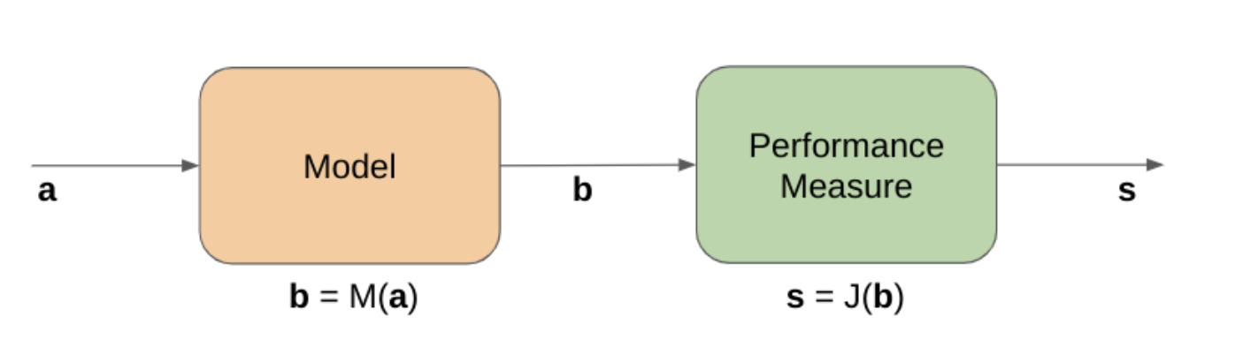
Meteorology
a=current weather (humidity, windspeed, temperature…)
b=tomorrow’s weather (same variables)

Slide 16
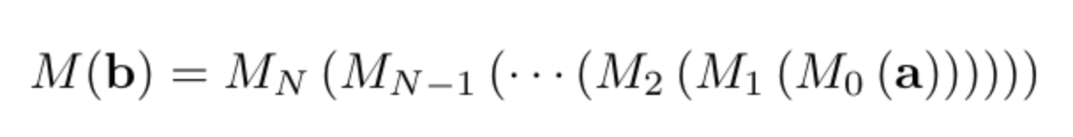
Computed using numerical integration
Euler’s method
Runge Kutta
Sensitivity of the result:
How much does the performance measure change if you perturb the input a little bit?

Slide 17
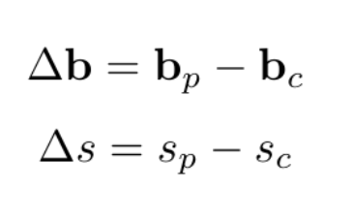
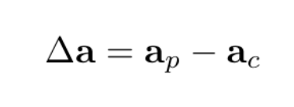
Sensitivity of a model
If you give basically the same current information, you should get the same next-state information
Imagine if you gave it 1mph lower windspeed and it said the temperature tomorrow was 50 degrees higher!
Computing sensitivity:

Slide 18
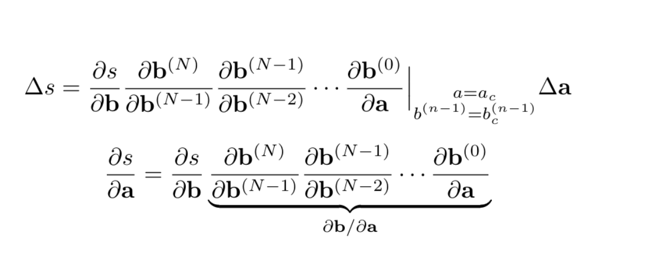
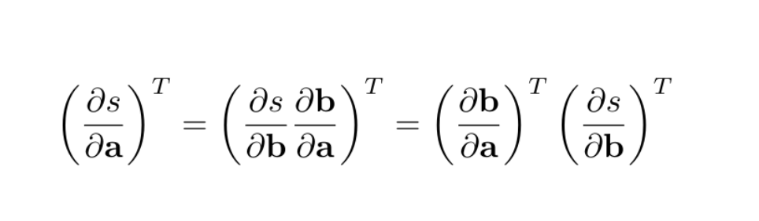
Sensitivity Equation

Slide 19
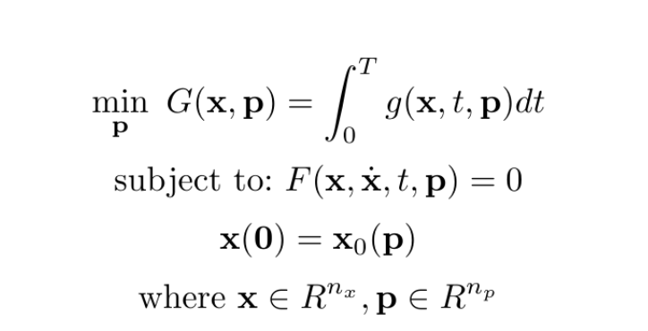
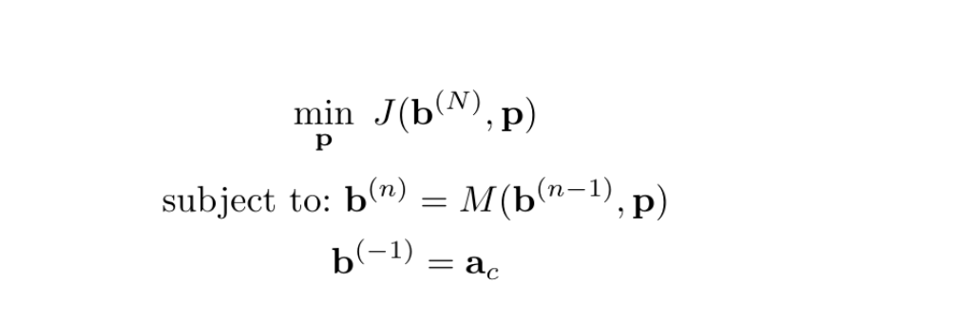
As a constrained optimization
Discrete Time
Continuous time, this can be solved
By an ODE solver it is a system of
Differential algebraic equations!

Slide 20
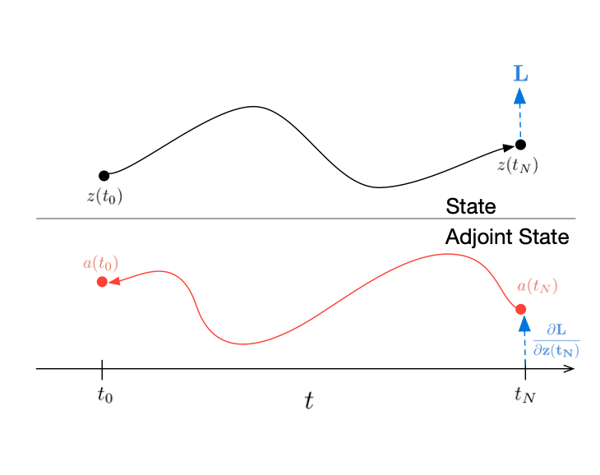
Low Memory Costs
No longer need to store intermediate values in the continuous case
You can reconstruct them as you go along by running the system in reverse!

Slide 21
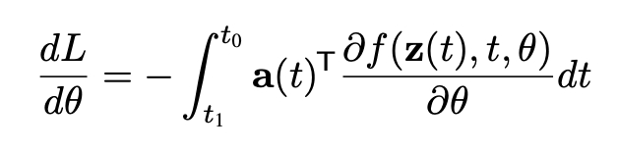
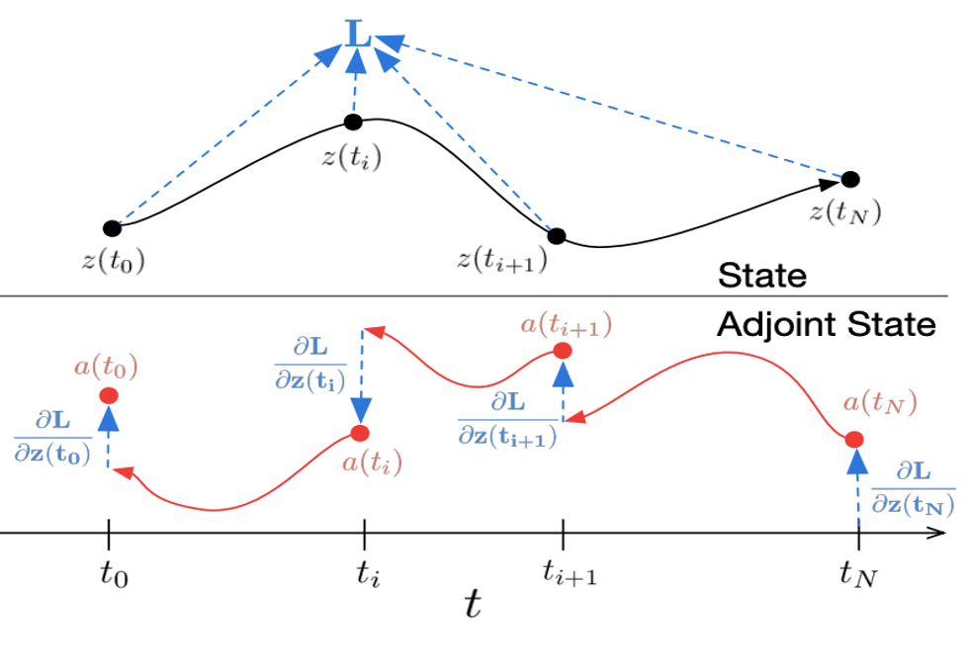
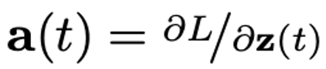
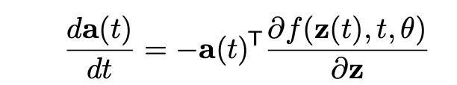
Adjoint Sensitivity in Neural ODE
Adjoint = derivative of Loss, Hidden State
or intermediate timepoint

Slide 23
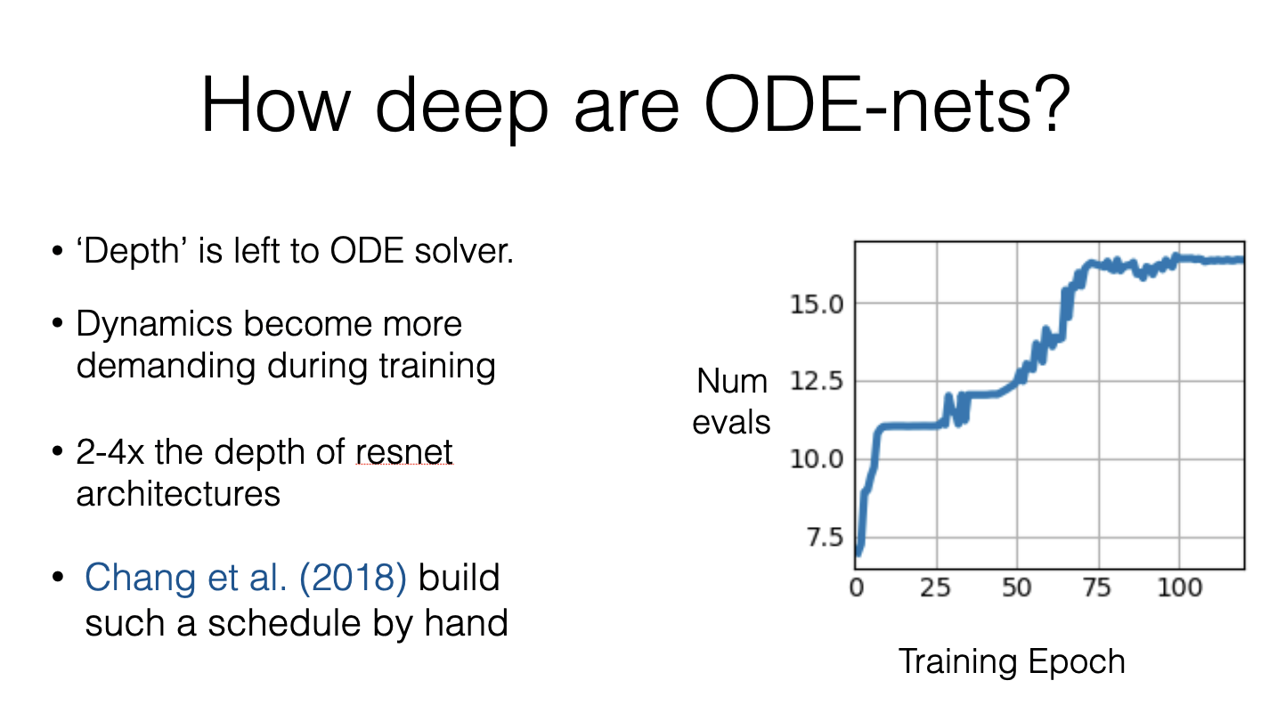

Slide 24
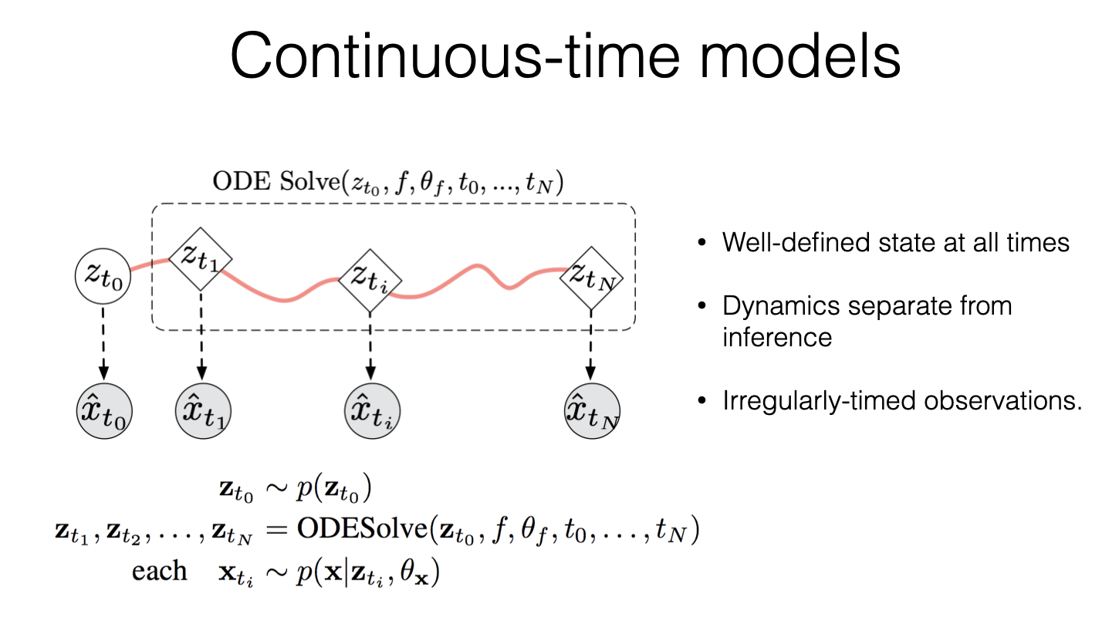

Slide 25
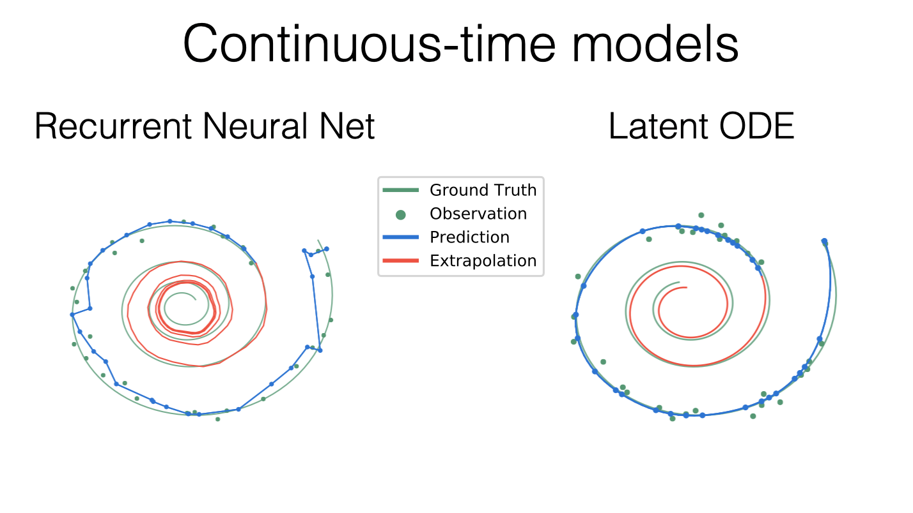

Slide 26
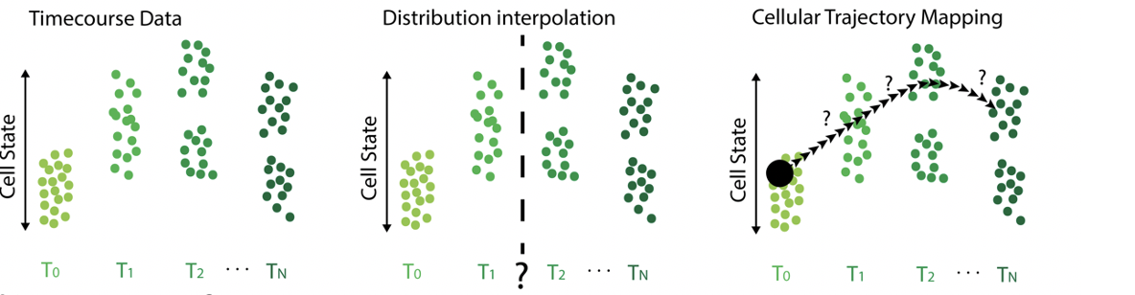
Dynamics from Static Snapshot Datasets

Slide 27
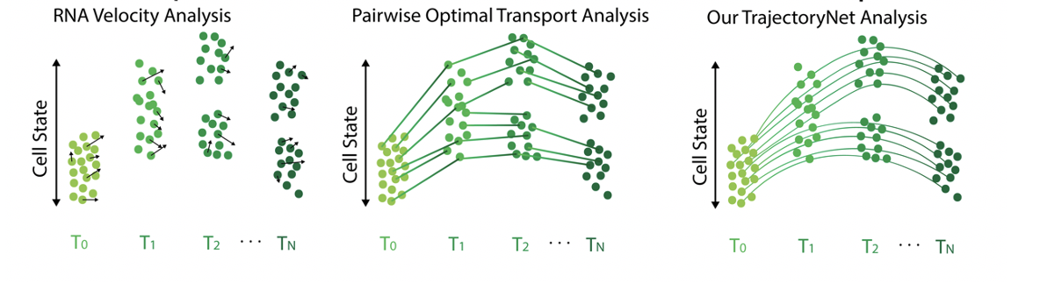
Comparison to Previous Methods
La Manno et al.
Nature
Schiebinger et al.
Cell
Tong et al.
ICML

Slide 28
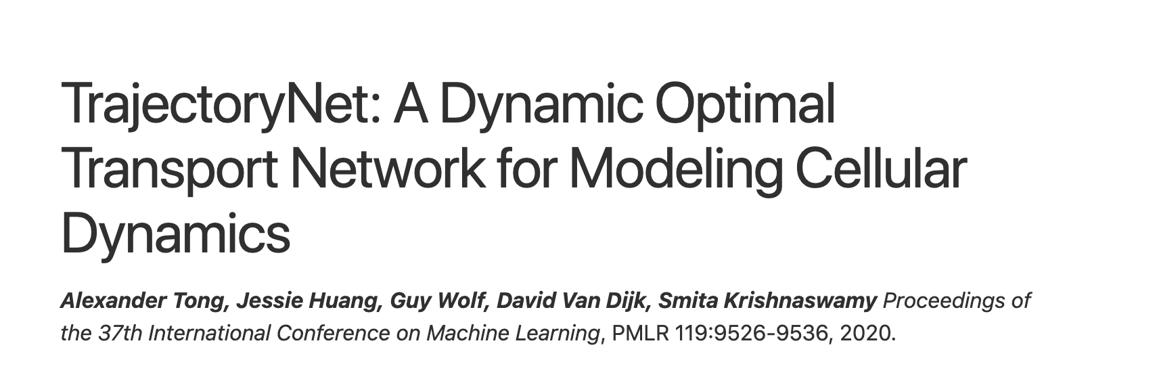
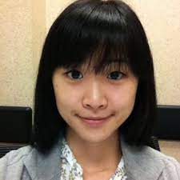

Slide 29
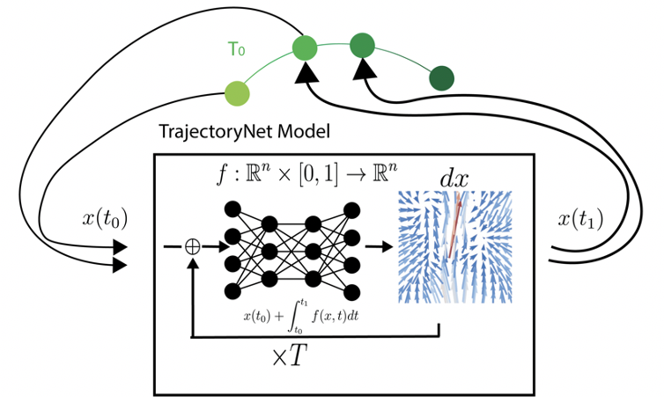
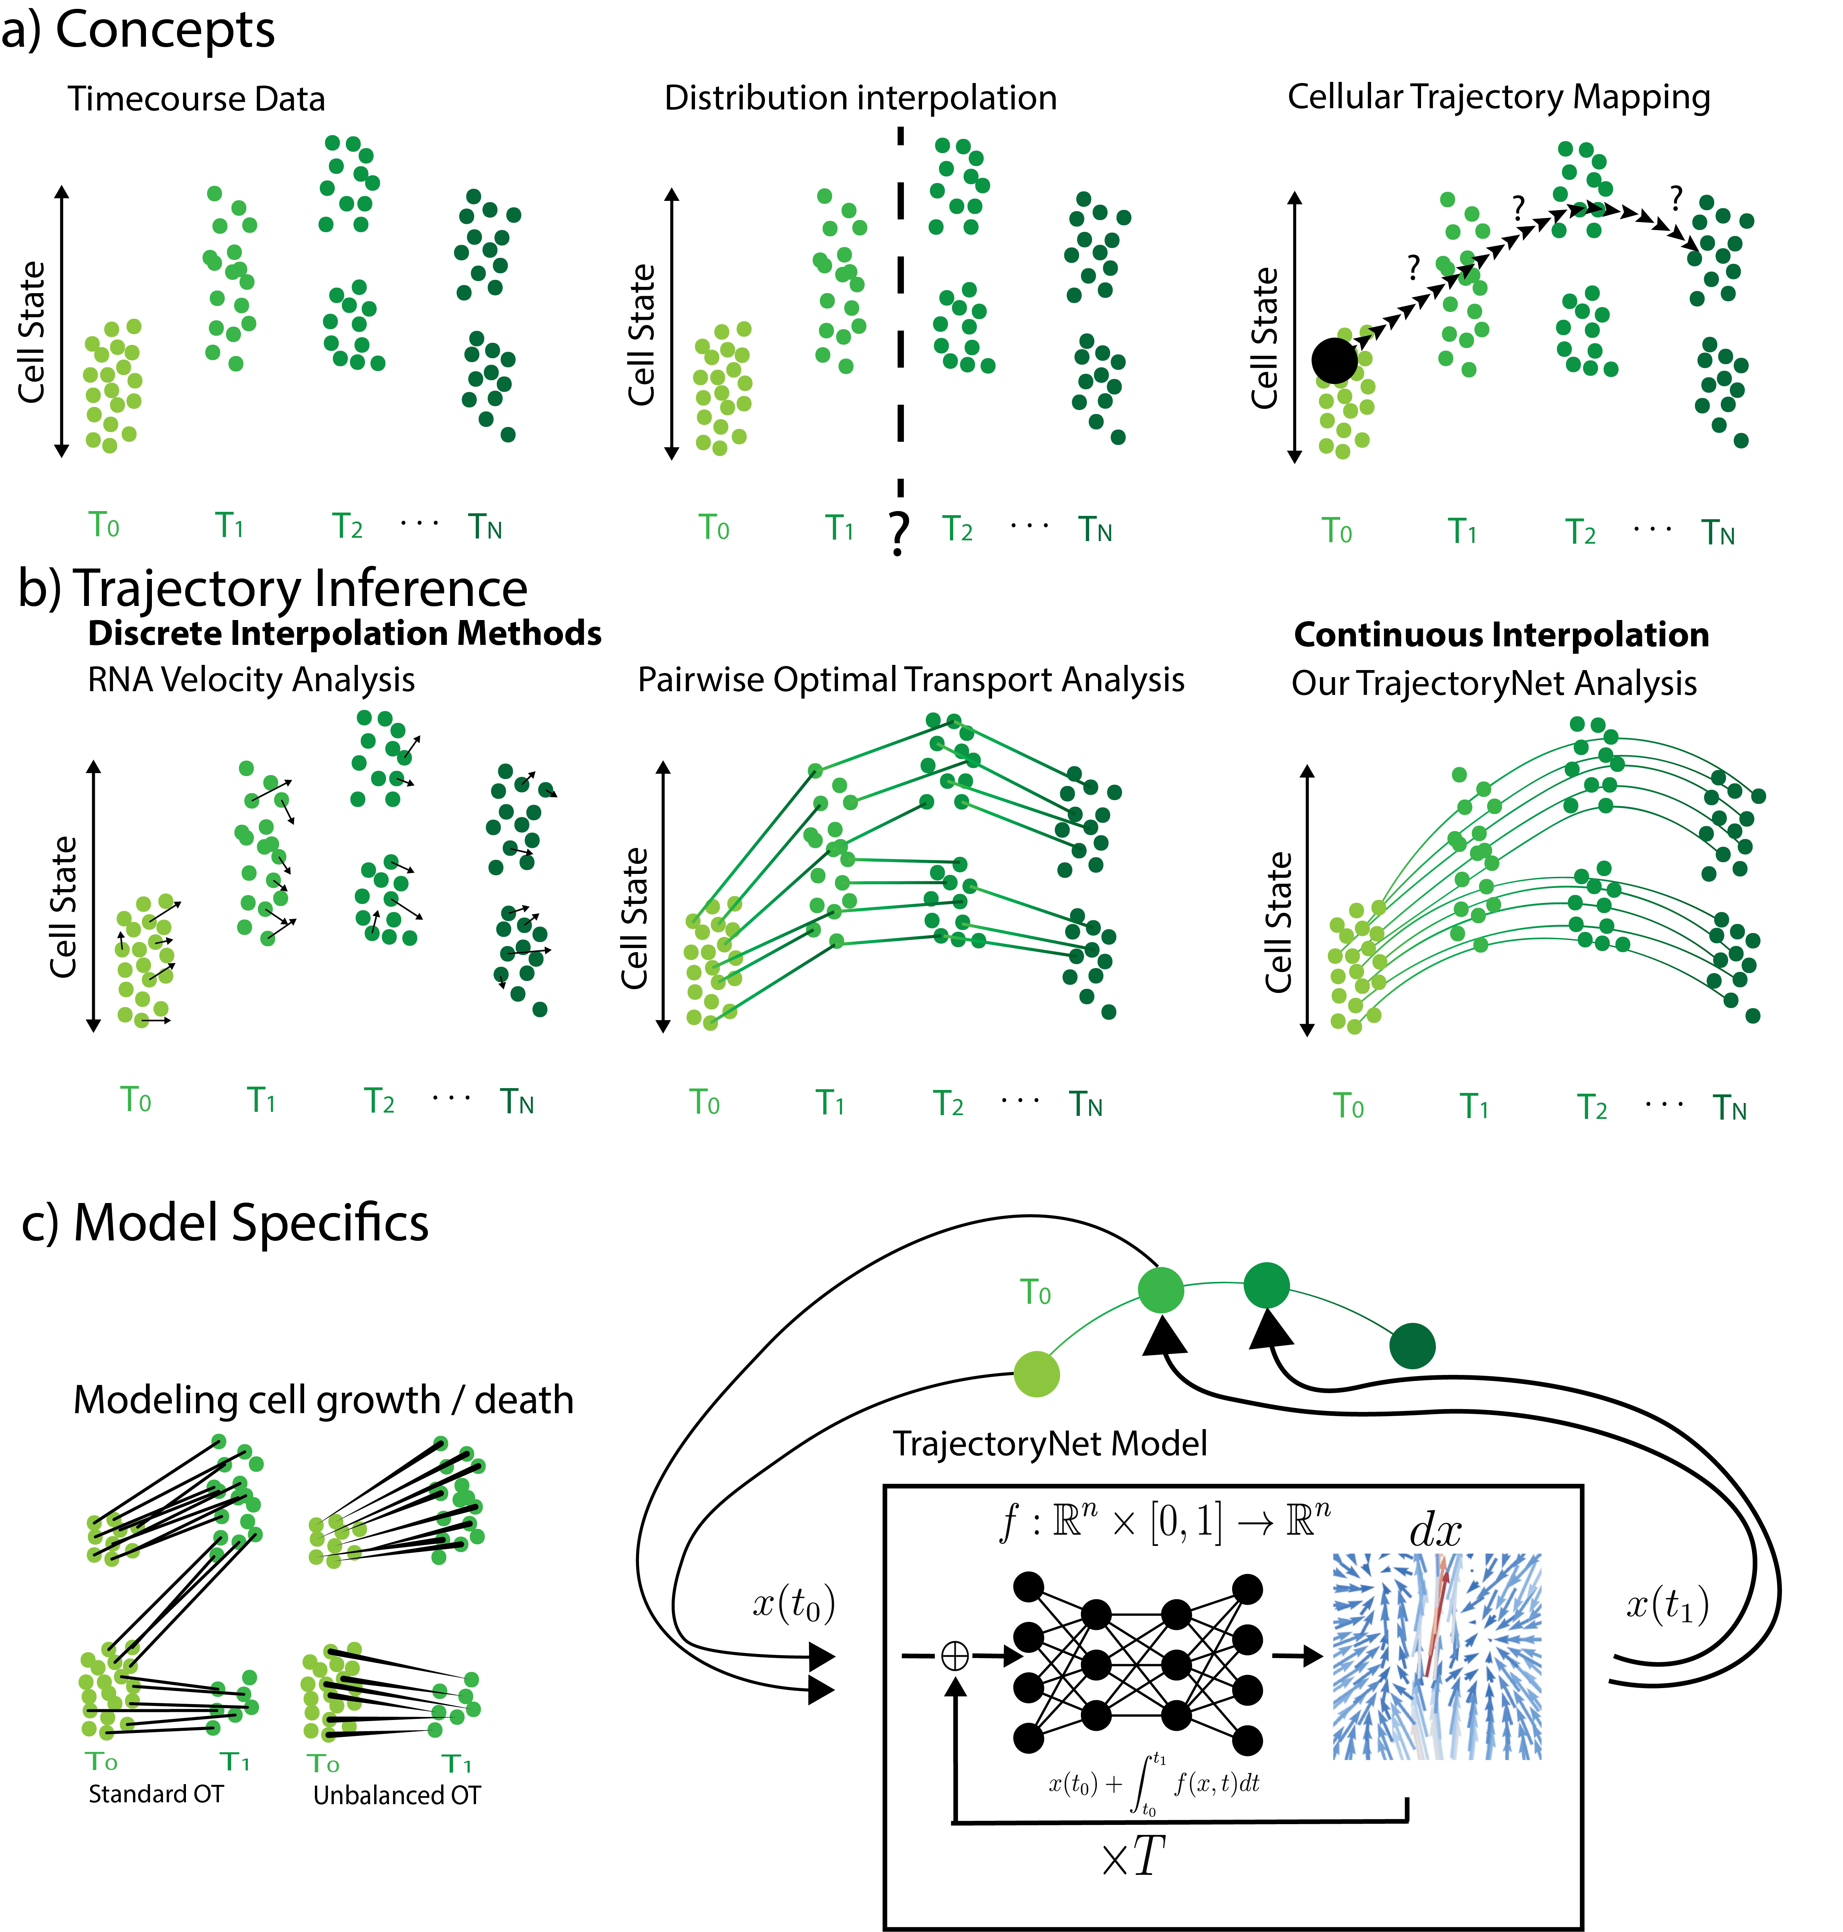
Neural ODE for Population Flow

Slide 30
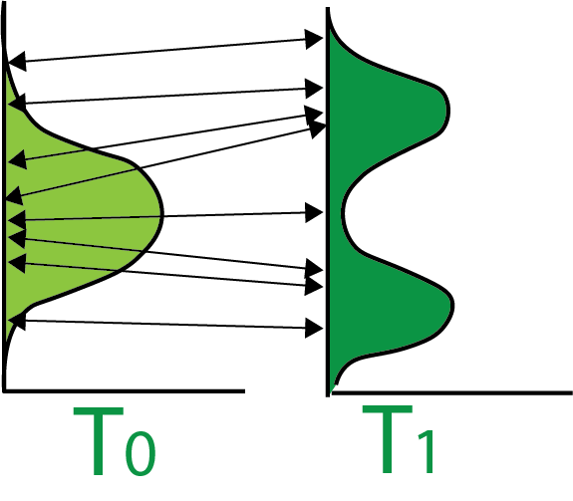
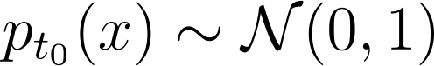
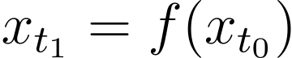
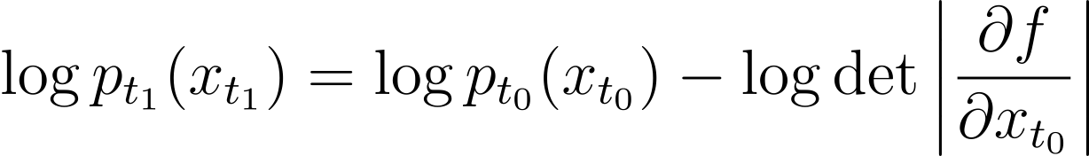
Normalizing Flows (NFs)
Begin with a simple distribution
Apply an invertible transformation(s)
Use change of variables to calculate probability
Notes:
First, before we get into continuous normalizing flows, a little bit about standard normalizing flows.
<next>
Normalizing flows transform a simple distribution often the standard Gaussian distribution, into a more useful one with an invertible neural network, or a series of invertible transformations.
<next>
The invertibility means that we can apply the change of variables formula to calculate the probability, or the log probability of any point at time t_1. This log probability then can be maximized according to the maximum likelihood principle.
<next>
Generally the challenge computationally is computing this log determinant,
<next>
Which turns out to be more efficient if we compose a series of simpler invertible transformations.
<next>
Composing a series of transformations is easy and is often thought of as composing layers in a neural network.
To calculate the log probability we now need to iterate backwards over the N transformations and sum up the log determinants.
-------------------
x_{t_1} = f(x_{t_0})
p_{t_0}(x) \sim \mathcal{N}(0,1)
\log p_{t_1}(x_{t_1}) = \log p_{t_0}(x_{t_0}) - \log \det \left | \frac{\partial f}{\partial x_{t_0}} \right |
\log p_{t_N}(x_{t_N}) = \log p_{t_0}(x_{t_0}) - \sum_{n=1}^N \log \det \left | \frac{\partial f_n}{\partial x_{t_{n-1}}} \right |

Slide 31
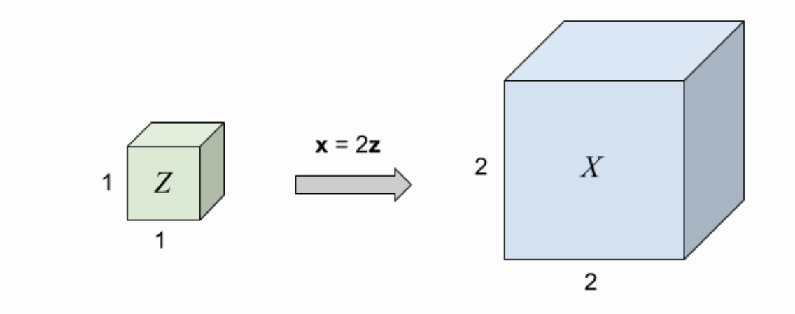
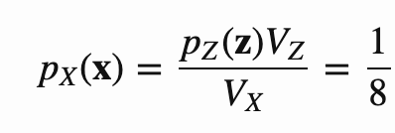
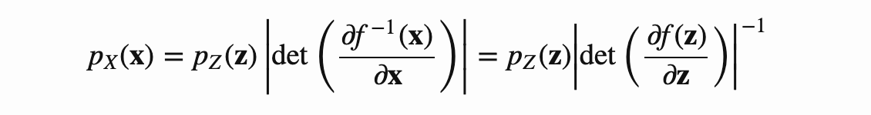
Change of variables formula: volume normalization

Slide 32
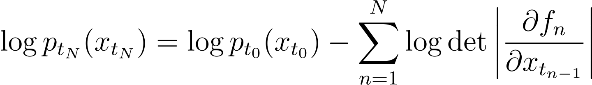
Deep Normalizing Flows (NFs)
Apply a series of transformations
Use change of variables to calculate probability
Notes:
First, before we get into continuous normalizing flows, a little bit about standard normalizing flows.
<next>
Normalizing flows transform a simple distribution often the standard Gaussian distribution, into a more useful one with an invertible neural network, or a series of invertible transformations.
<next>
The invertibility means that we can apply the change of variables formula to calculate the probability, or the log probability of any point at time t_1. This log probability then can be maximized according to the maximum likelihood principle.
<next>
Generally the challenge computationally is computing this log determinant,
<next>
Which turns out to be more efficient if we compose a series of simpler invertible transformations.
<next>
Composing a series of transformations is easy and is often thought of as composing layers in a neural network.
To calculate the log probability we now need to iterate backwards over the N transformations and sum up the log determinants.
------------
p_{t_0}(x) \sim \mathcal{N}(0,1)
x_{t_1} = f(x_{t_0})
x_{t_N} = f_N \circ f_{N-1} \circ \cdots \circ f_1(x_{t_0})
\log p_{t_1}(x_{t_1}) = \log p_{t_0}(x_{t_0}) - \log \det \left | \frac{\partial f}{\partial x_{t_0}} \right |
\log p_{t_N}(x_{t_N}) = \log p_{t_0}(x_{t_0}) - \sum_{n=1}^N \log \det \left | \frac{\partial f_n}{\partial x_{t_{n-1}}} \right |

Slide 33
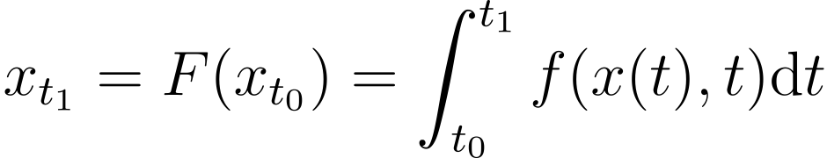
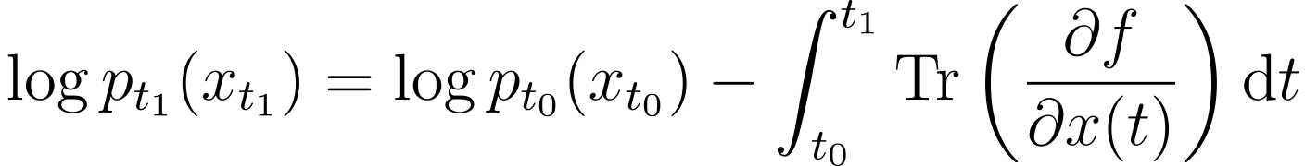
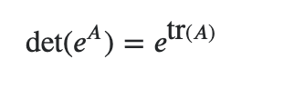
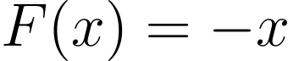
Continuous Normalizing Flows
Instantaneous change of variables
Cannot model:
[Chen et al. 2018]
Notes:
As presented in Chen et al.’s paper Neural ODE, continuous normalizing flows take the number of layers to the limit, directly modeling the derivative of the flow, and integrating this derivative using standard numerical methods for solving ordinary differential equations to solve for X at time t_1. There are two useful side effects of taking the number of layers to the limit, the first is that the log determinant computation simplifies to a trace over the Jacobian, simplifying things computationally, although the integration time still dominates. The other useful side effect other is that flows cannot “cross” in an ODE. This means that they cannot model some relatively simple invertible functions like F(x) = -x. This is a problem for some applications, but we will show how it is useful in modeling cells.
---------------------
x_{t_1} = F(x_{t_0}) = \int_{t_0}^{t_1} f(x(t),t) \textup{d}t
\log p_{t_1}(x_{t_1}) = \log p_{t_0}(x_{t_0}) - \int_{t_0}^{t_1} \textup{Tr}\left ( \frac{\partial f}{\partial x(t)} \right ) \textup{d}t
As presented in Chen et al.’s paper Neural ODE, continuous normalizing flows take the number of layers to the limit, directly modeling the derivative of the flow, and integrating this derivative using standard numerical methods for solving ordinary differential equations to solve for X at time t_1. There are two other useful side effects of taking this limit, the first is that the log determinant computation simplifies to a trace over the jacobian, simplifying things computationally, the other is that flows cannot “cross” in an ODE. This means that they cannot model some relatively simple invertible functions like F(x) = -x. This is a problem for some applications, but we will show how it is useful in modeling cells.

Slide 34
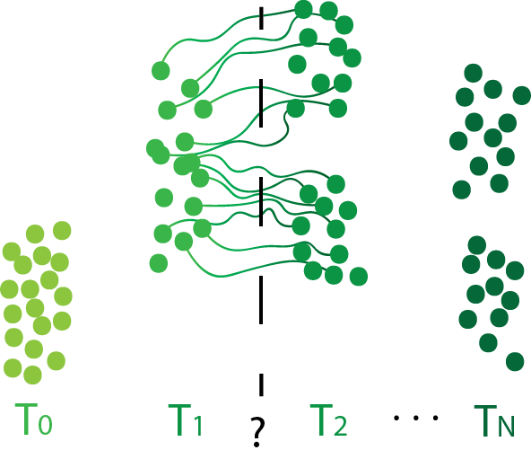
CNFs create continuous paths
Creates continuous paths, but they may not be biologically plausible — no restriction on circuitous paths!
[Chen et al. 2018]
Notes:
Continuous normalizing flows can be used to transport populations along time but may produce implausible or circuitous paths.
----------------
Literature on normalizing flows and continuous normalizing flows has focused on the generated output. In this project we are interested in the paths taken between distributions. With continuous normalizing flows we can conceptualize this as the smooth paths taken over time.
We can think of CNFs as optimizing for a set of paths where the start of the paths is a fixed simple distribution, and the ends of the paths are optimized to match some target distribution. This only constrains the distributions of the ends of the paths. Leaving the mapping between nodes and the middle of the paths unconstrained.

Slide 35

Obtain More Realistic Paths via Regularization

Slide 36




Dynamic Optimal Transport
Dynamic OT:
𝜇
𝜈
Subject to:
Benamou and Brenier 2000
Notes:
Optimal transport studies how to move mass with minimal cost. For example, we have some pile of dirt represented by distribution mu at time 0 and want this dirt to be piled according to distribution \nu at time 1. This is traditionally solved as a linear program to determine the mapping between points at time 0 to time 1. However, this can also be interpreted in terms of dynamic optimal transport, which models the full path of particles over over time. Dynamic OT shows that optimizing a flow function f where the particles move the minimum expected distance and match the distributions at the beginning and end timepoints, then the expected distance a particle moves is equivalent to the Wasserstein distance.
<next>
Connecting this to normalizing flows with a squared L_2 penalty over f, the only difference is that the probability at time 1 is not fixed to \nu, but instead we optimize for the maximum likelihood at time 1, which is equivalent to optimizing the KL divergence between our flow at time 1, and the distribution \nu. As the KL-divergence term gets small then these flows are equivalent. For a more precise treatment see the paper.
-------------
W(\mu, \nu)^2_2 = \underset{\text{Eulerian frame}}{\underbrace{\inf_{p,f} \int_{\mathbb{R}^d} \int_0^1 p(x,t) \left \| f(x,t) \right \| \textup{d}t \textup{d}x}} = \underset{\text{Lagrangian frame}}{\underbrace{\inf_{p,f} \mathop{\mathbb{E}}_{x_0 \sim \mu} \int_0^1\left \| f(x(t),t) \right \| \textup{d}t}}
Here we use the squared L_2 distance as the cost of moving dirt from one location to another.

Slide 37

Regularized CNF approximates dynamic optimal transport
Dynamic OT: regularized CNF
𝜇
𝜈
Subject to:
Notes:
Optimal transport studies how to move mass with minimal cost. For an example we have some pile of dirt represented by distribution mu at time 0 and want this dirt to be piled according to distribution \nu at time 1. Here we use the squared L_2 distance as the cost of moving dirt from one location to another. This is the also known as the 2-Wasserstein distance. This is traditionally taken as a linear program to determine the mapping between points at time 0 to time 1. However, this can also be interpreted in terms of dynamic optimal transport, which models the full path of particles over over time. Dynamic OT shows that optimizing a flow function f where the particles move the minimum expected distance and match the distributions at the beginning and end timepoints, the the expected distance a particle moves is equivalent to the Wasserstein distance.
<next>
Connecting this to normalizing flows with a squared L_2 penalty over f, the only difference is that the probability at time 1 is not fixed to \nu, but instead we optimize for the maximum likelihood at time 1, which is equivalent to optimizing the KL divergence between our flow at time 1, and the distribution \nu. As the KL-divergence term gets small then these flows are equivalent. For a more precise treatment see the paper.
W(\mu, \nu)^2_2 = \underset{\text{Eulerian frame}}{\underbrace{\inf_{p,f} \int_{\mathbb{R}^d} \int_0^1 p(x,t) \left \| f(x,t) \right \| \textup{d}t \textup{d}x}} = \underset{\text{Lagrangian frame}}{\underbrace{\inf_{p,f} \mathop{\mathbb{E}}_{x_0 \sim \mu} \int_0^1\left \| f(x(t),t) \right \| \textup{d}t}}
\underset{\text{Mass is preserved}}{\underbrace{\partial_t p + \nabla \cdot (pf) = 0}}
p(\cdot, 0) = \mu
p(\cdot, 1) = \nu
{\color{Red} \textup{KL}(p(\cdot, 1), \nu)}

Slide 38

CNFs model Dynamic Optimal Transport
Notes:
For example, let’s examine the CNF that maps a 2d Gaussian to this distribution over the letter “S”. We show the paths over time of particles from red to blue, using different optimization strategies. Without regularization the CNF takes reasonable paths that are dictated by the implicit biases of the network architecture and optimization. Add this squared L_2 penalty to the flow function also known as the energy penalty, and we recover paths that are close to the optimal transport solution.

Slide 39
Dynamic OT via TrajectoryNet
Dynamic OT via TrajectoryNet can be utilized to infer continuous trajectories of any populations adhering to energy or transport constraints
Population migration
Disease spread
However, cellular systems are more constrained, and other domain specific priors apply
Notes:
So just to recap, at this point we have the baseline Trajectorynet model a continuous normalizing flow with energy penalty, which can be useful in other applications where energy is approximately minimized, but we can do better for modeling cells. We have more information about cellular systems which we will next show how to use to build a more accurate model.

Slide 40


PHATE: Embryonic Stem Cell Data
Natalia Ivanova
27 day timecourse collected at 5 timepoints
[Moon et al. Nature Biotechology 2019]
Notes:
First, a little bit about the data, as an example system, we take this Embryoid body development data. These are human embryonic stem cells that are collected over 27 days at 5 timepoints, that start as stem cells and form distinct groups of precursor cells, such as cardiac, blood, and muscle precursors.

Slide 41



Inferring Continuous Flow in Static Snapshots
genes
cells
Notes:
At each timepoint the data is a static snapshot of gene profiles, i.e. a set of cells each with a vector of counts over ~20-30 thousand genes.

Slide 42
Additional Properties of cells
Cells are not simply transported from one timepoint to another, they cells divide and die.
Cells cannot travel in straight paths through Euclidean space in terms of measured dimensions, cells only travel along a cellular manifold.
Though cells are destroyed when measured, we can estimate their direction of transition-based RNA velocity
Notes:
There are some additional properties of cells:
First, cells move, but they also grow and die, which we can model as an unbalanced transport problem.
Second, cells travel along a dense cellular manifold that is not linear in the ambient space.
And third, recent work based on RNA-splicing shows how to measure the approximate change in transcriptome for measured cells. This is termed “RNA-velocity,” and gives an estimate of the direction of each cell at the measured time.
These additional priors can improve our model of the transcriptome and can be efficiently encoded through the loss function of the continuous normalizing flow.

Slide 43
Cell Death and Growth
Allowing unbalanced transport can let cells “die” instead of moving them to implausible locations
Unbalanced transport hard to achieve dynamically
We use discrete optimal transport to assign growth and death rates
Liero et al. 2018
Notes:
To model cell growth and death we use unbalanced transport, which allows for the creation and destruction of mass at some cost. It is difficult learn the growth and death along with a flow, so we learn a separate model instead.
We use discrete optimal transport to estimate growth and death rates and learn a continuous model that is regularized by these values.
-----------------------------
Here we model growth through a separate network G trained from discrete unbalanced transport. We model the growth over time with this network. Red indicates relative growth at that time and position and blue indicates death. These growth values are added to the mass calculation, if the growth network outputs 2, this means a doubling of mass at that point. An output of 0.5 indicates a halving, and 1 indicates no change.

Slide 44
Cellular Manifolds
Implausible path
Cells have to transition through allowable parts of the state space
Enforce this with a density penalty. Based on a knn density estimate
Notes:
Cellular state space is lower dimensional than the ambient measurement space, cells grow and differentiate in a restricted smooth manifold. We constrain the flow as much as possible to areas where there is density. To avoid implausible paths through no density.
<next>
This loss is a hinge penalty on the k nearest neighbors, for some randomly interpolated timepoint t, if your k nearest neighbors are beyond some radius h, then we encourage the path to be closer to those neighbors.
This trades off energy efficiency for our prior that cells follow a low dimensional manifold.

Slide 45

Velocity Regularization
RNA Velocity, estimate of direction of change
[La Manno et al. 2018 Velocyto; Volker et al. ScVelo]
Notes:
RNA velocity gives a local estimate of cellular change, depicted here on this plot, it is also empirically extremely noise. We find it gives a good estimate of direction, but not of overall magnitude. Thus we penalize the cosine distance between our predicted direction of change f, and the RNA velocity at all datapoints.
This matches direction but ignores magnitude.

Slide 46

Toy Example
Notes:
To give an example of what this looks like, we show a simplified example. Here we embed some 1d distributions on a 1d manifold in 2 dimensions. The gray distribution is computed with optimal transport in 1D, i.e. along the manifold. We train the model to map the distribution at time 0 to the distribution at time 1. With the idea that at time ½ we should match the gray distribution. These arrows model the flow, and the points show the distribution. The base model shows how without these additional penalties we move in straight lines, splitting density immediately. With density or velocity penalties we follow the 1d manifold and approximately match the gray distribution at time ½.

Slide 47


Continuous Trajectories in Single Cell Data
Single Cell Trajectories
Notes:
These penalties allow us to impute the density at any timepoint, or track the likely ancestry or descendent transcriptomes of individual cells. Here visualized on the embryoid body dataset.

Slide 48

Results — Embryoid body dataset
Wasserstein distance between predicted and true distributions for different left out timepoints
Different regularizations have different assumptions and tradeoffs
Notes:
To evaluate our model, we use the Wasserstein distance between the predicted and ground truth distributions for models trained while leaving out one timepoint. We find the different regularizations have different tradeoffs based on the assumptions they make. For example, growth is most different across cells early, thus taking into account growth is most important when leaving out timepoint 1. While when leaving out the second timepoint, density regularization is especially important.

Slide 49




Epithelial Phenotype
EMT
Mesenchymal Phenotype
MET
Beatriz Perez
EMT is relatively well-studied but MET which is equally important is
Not studied well because of the need for 3D culture conditions
Here we are studying Triple Negative Breast Cancer, which
has no targeted therapies.
Christine Chaffer

Slide 50




Mamospheres
Day 2
Day 12
Single cells
Day 18
Day 30

Slide 51

Trying to Understand the Landscape of the Cancer State Space

Slide 52

5-point timecourse of mamosphere culture

Slide 53


4-Timepoints of MET

Slide 54


Tracing Cells Backwards
Notes:
Chrstine wanted to see, Zeb2 down, what goes up and what goes down, ordering by events that happen during MET. Genes with sm
Promorter region looking at the lag. LAG of the chromatin.
Temporality of the decision.

Slide 55

Cells of Origin

Slide 56

Validation

Slide 57

Gene Regulatory Programs

Slide 58
Reading list
Chen et al. NeurIPS 2018 Neural Ordinary Differential Equations
Tong et al. ICML 2020 TrajectoryNET
Errico 1997 Adjoint Model
https://towardsdatascience.com/the-story-of-adjoint-sensitivity-method-from-meteorology-906ab2796c73

